Slide 1

A Story based on Stock Market time series data
Ramesh babu

Slide 2
Time-series & forecasting
Time-series forecasting models are the models that are capable to predict future values based on previously observed values. Time-series forecasting is widely used for non-stationary data. Non-stationary data are called the data whose statistical properties e.g. the mean and standard deviation are not constant over time but instead, these metrics vary over time.

Slide 3
A time series
These non-stationary input data (used as input to these models) are usually called time-series.
the input is a signal (time-series) that is defined by observations taken sequentially in time.
A time series is a sequence of observations taken sequentially in time.
Time-series data is recorded on a discrete time scale.

Slide 4
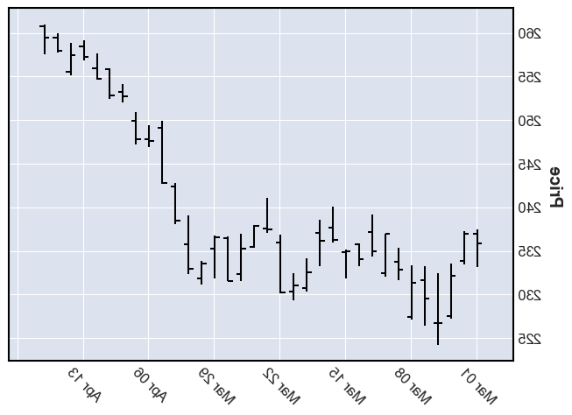
Bar charts
Bar charts (HLC / OHLC) Looking at each day’s history, a vertical line shows the day’s trading range with a horizontal line pointing left to mark the opening price and a horizontal line pointing right to mark the closing price.

Slide 5
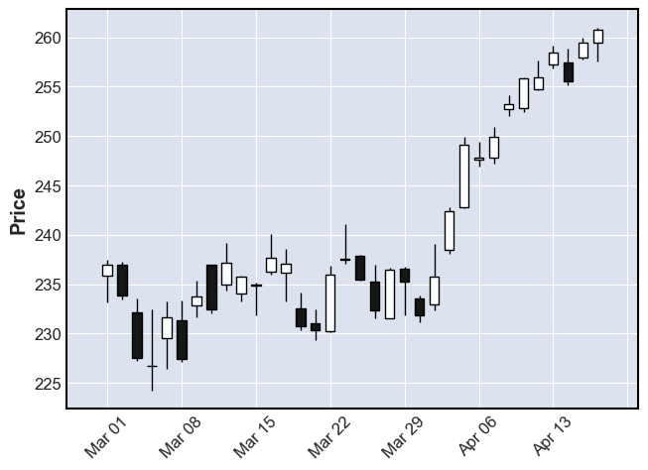
Candlestick charts
Candlestick charts The chart has two main parts. The first is the thin line, known as the “shadow,” which shows the price range from high to low. The wider area, known as the “real body,” measures the difference between the opening price and the closing price. If the close is higher than the open, the real body is white.

Slide 6
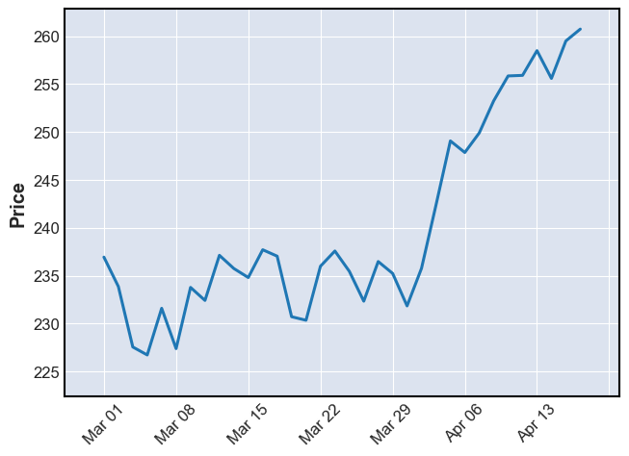
Line charts
Line charts – A line chart measures only the closing price and connects each day’s close into a line. Many technicians believe closing price is the only point that matters. For them, a line chart may be the most appropriate study.

Slide 7
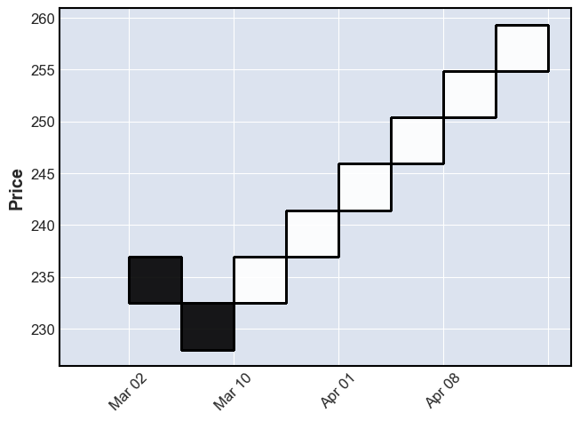
Renko chart
A Renko chart is a type of chart, developed by the Japanese, that is built using price movement rather than both price and standardized time intervals like most charts are. It is thought to be named after the Japanese word for bricks, "renga," since the chart looks like a series of bricks. By employing Renko charts we remove the time element and only focus on the price isolating the trend

Slide 8
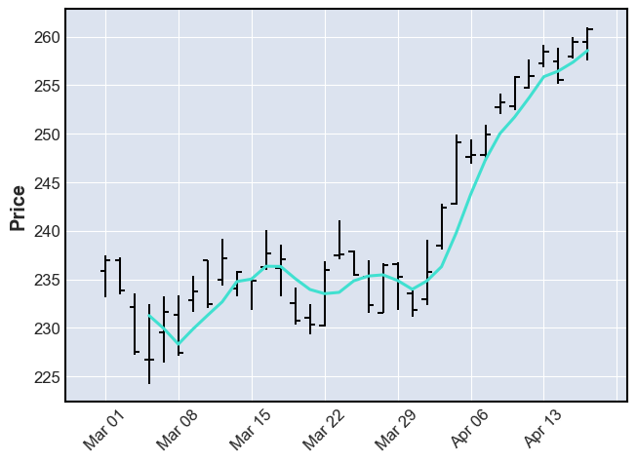
OHLC chart
An OHLC chart is a type of bar chart that shows open, high, low, and closing prices for each period. OHLC charts are useful since they show the four major data points over a period, with the closing price being considered the most important by many traders.

Slide 9
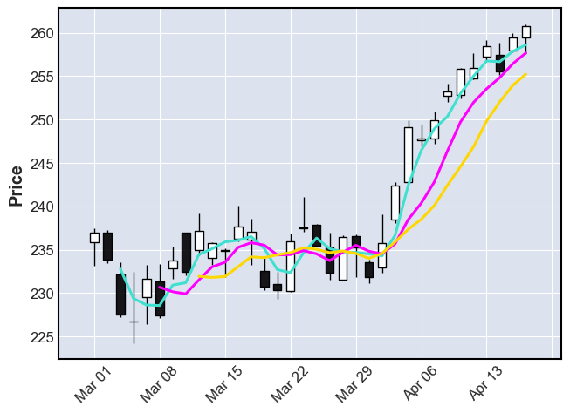
Moving average candle graph

Slide 10
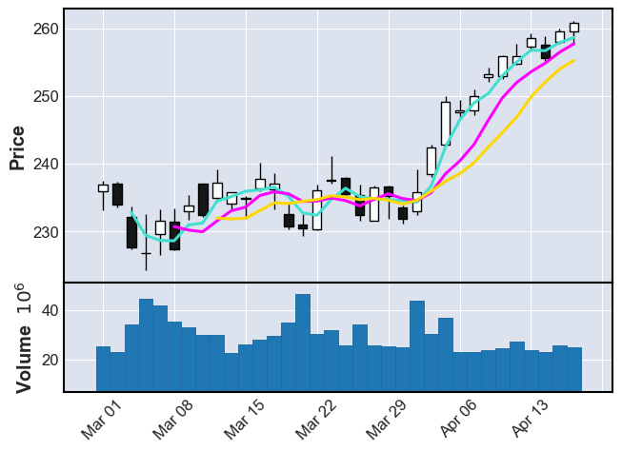
Moving average candle graph with volume

Slide 11
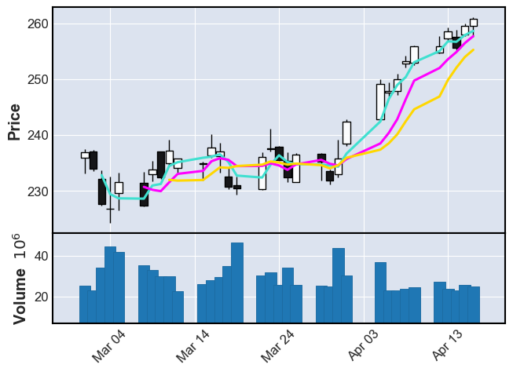
Cont.. show_nontrading

Slide 12
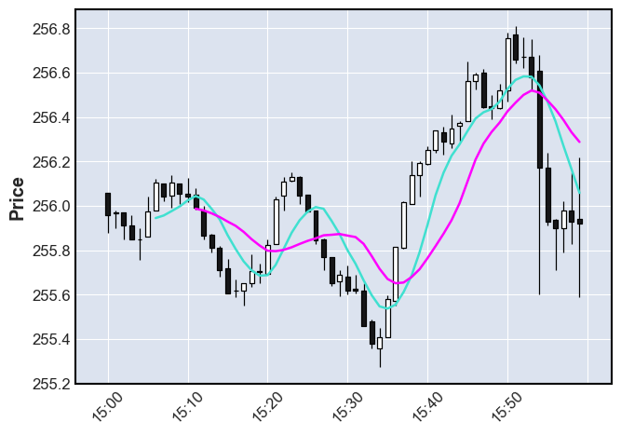
Intraday ('2021-04-12 15:00':'2021-04-12 16:00‘) last hour of trading on April 12th, with a 7 minute and 12 minute moving average.

Slide 13
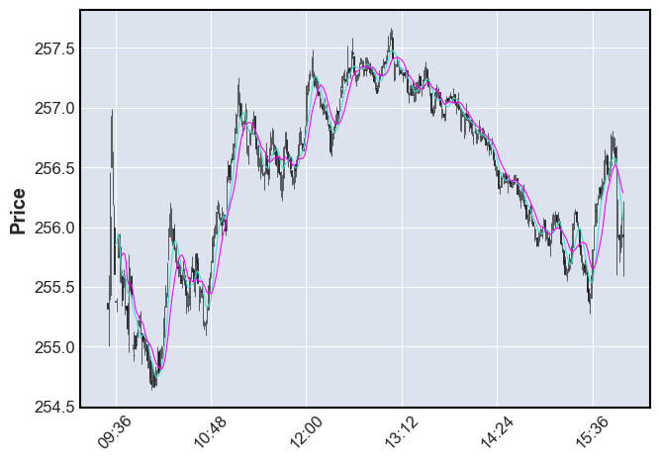
Intraday moving average(7m & 12m) with show_nontrading

Slide 14
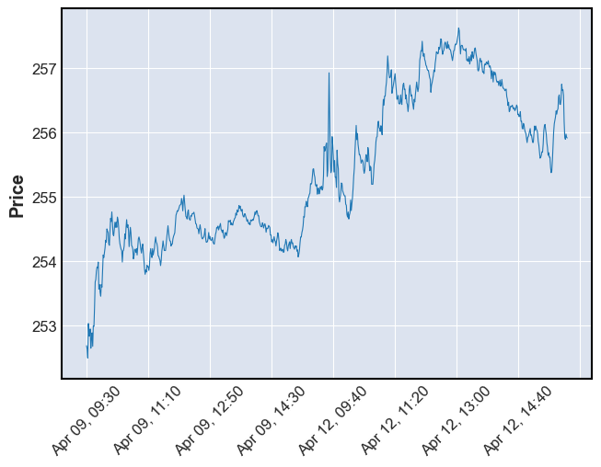
Interday line graph

Slide 15
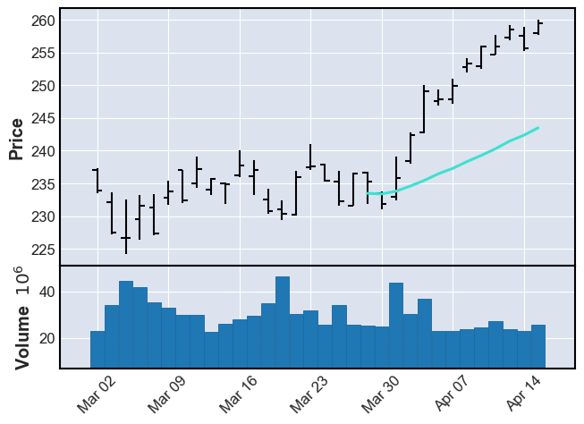
Moving average(20m& 40m) ohlc bar graphs

Slide 16
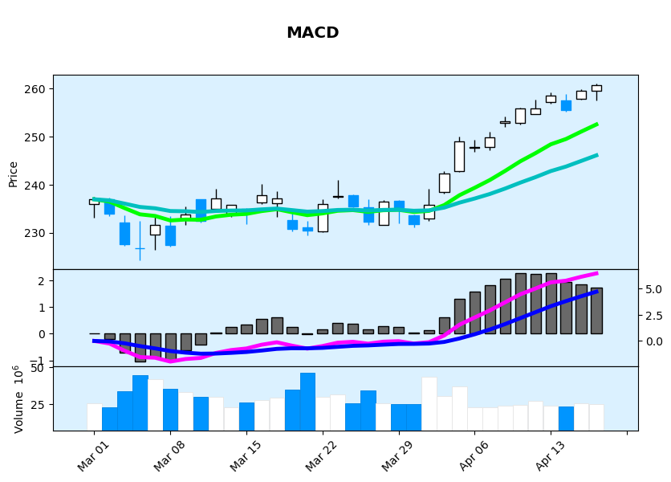
Moving average convergence divergence (MACD)
Moving average convergence divergence (MACD) is a trend-following momentum indicator that shows the relationship between two moving averages of a security's price. ... Traders may buy the security when the MACD crosses above its signal line and sell—or short—the security when the MACD crosses below the signal line.

Slide 17
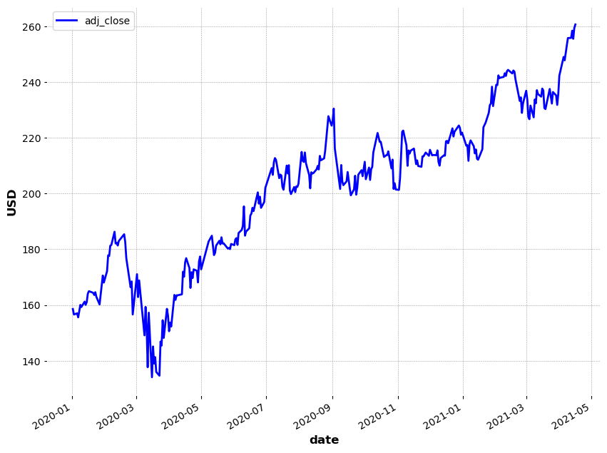
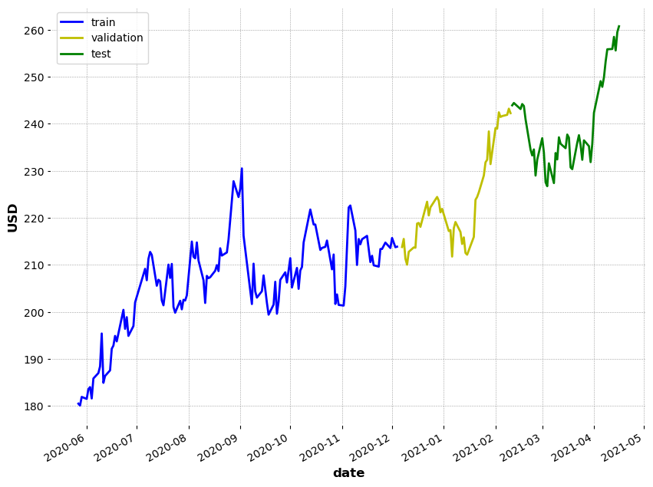
Stock Prediction using moving average

Slide 18
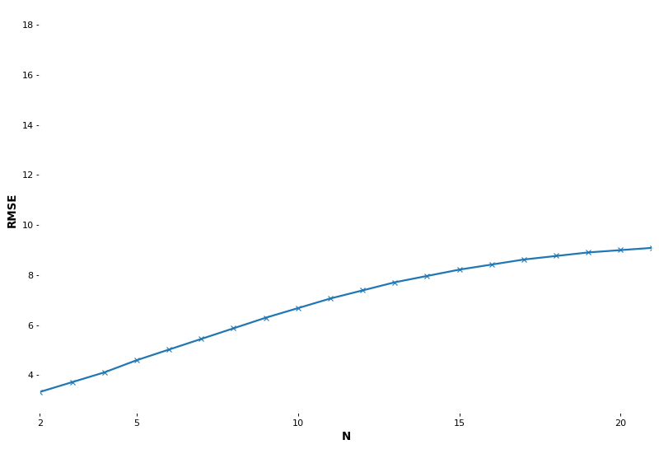
RMSE
The root-mean-square error (RMSE) is a measure of how well our model performed. It does this by measuring a difference between predicted values and the actual values.

Slide 19
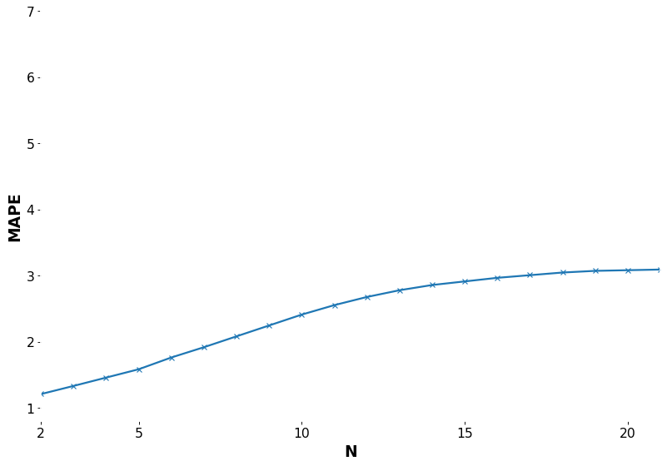
Monetary-Adjusted Price-Earnings (MAPE)
MAPE is a valuation measure generally applied to broad equity indices by using adjusted per-share earnings over a 10-year period with current levels for the equity indices. ​ The MAPE ratio is calculated by taking the annual Earnings Per Share (EPS) of an equity index such as the S&P 500 for the past 10 years.

Slide 20
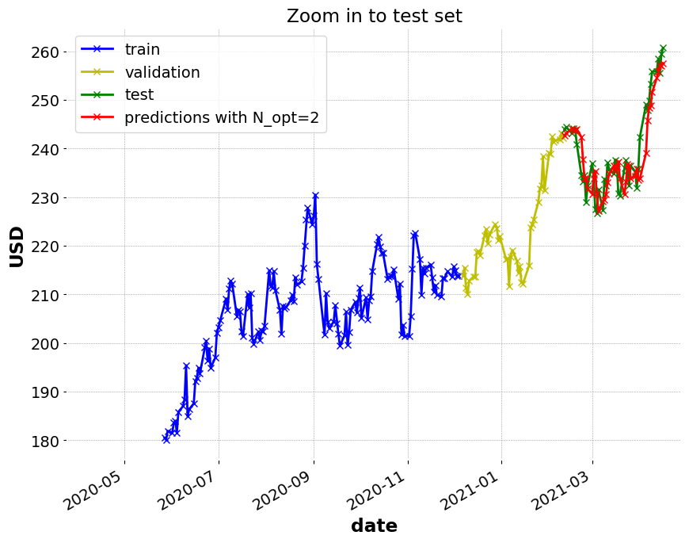
Prediction based on historical data
The End

